Slide 1
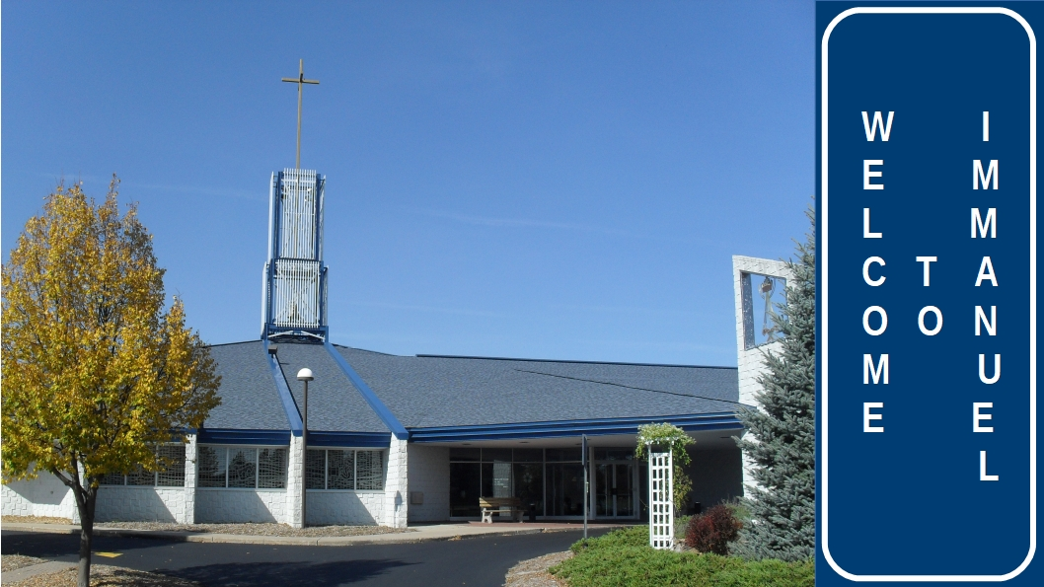

Slide 2


Slide 3
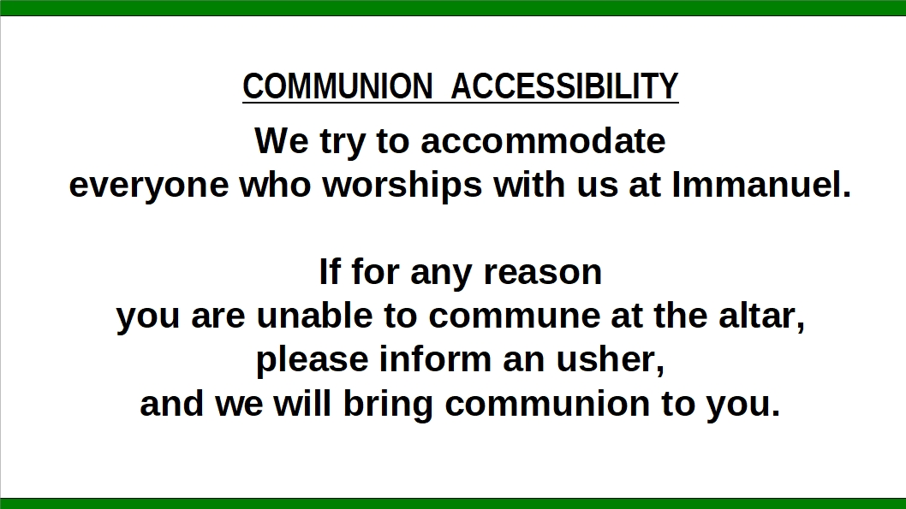

Slide 4


Slide 5


Slide 6
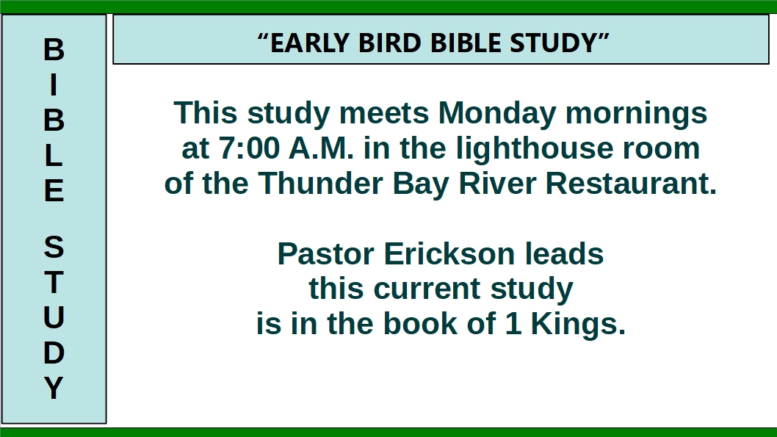

Slide 7
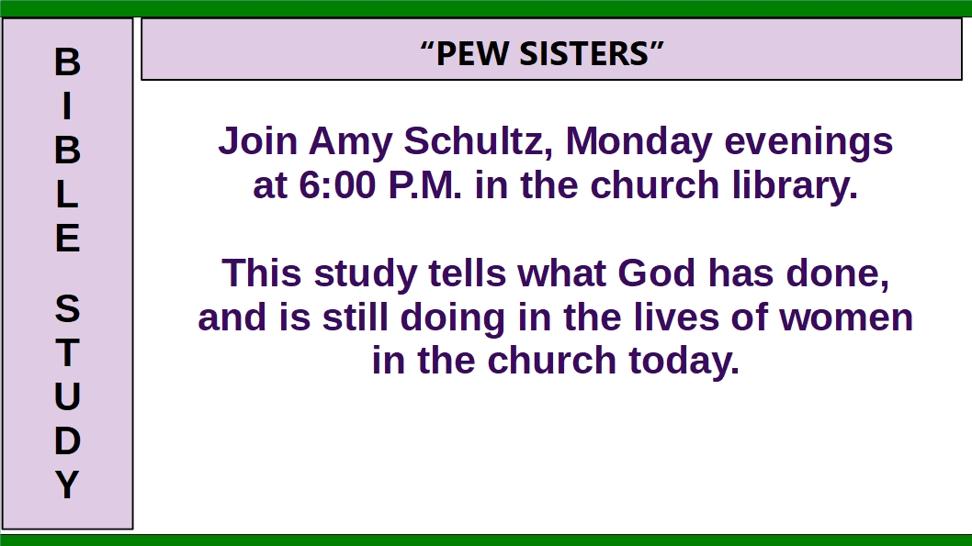

Slide 8
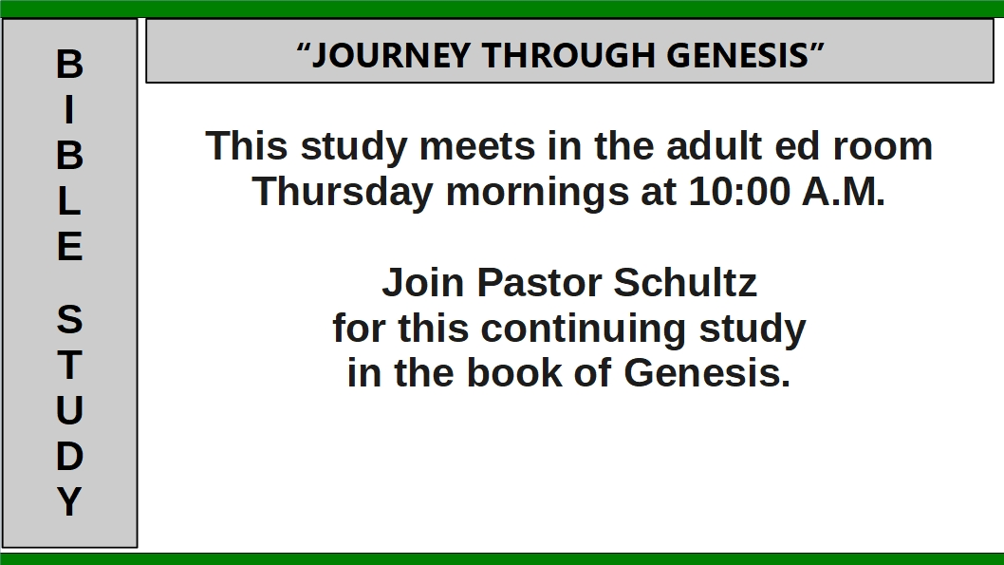

Slide 9


Slide 10


Slide 11

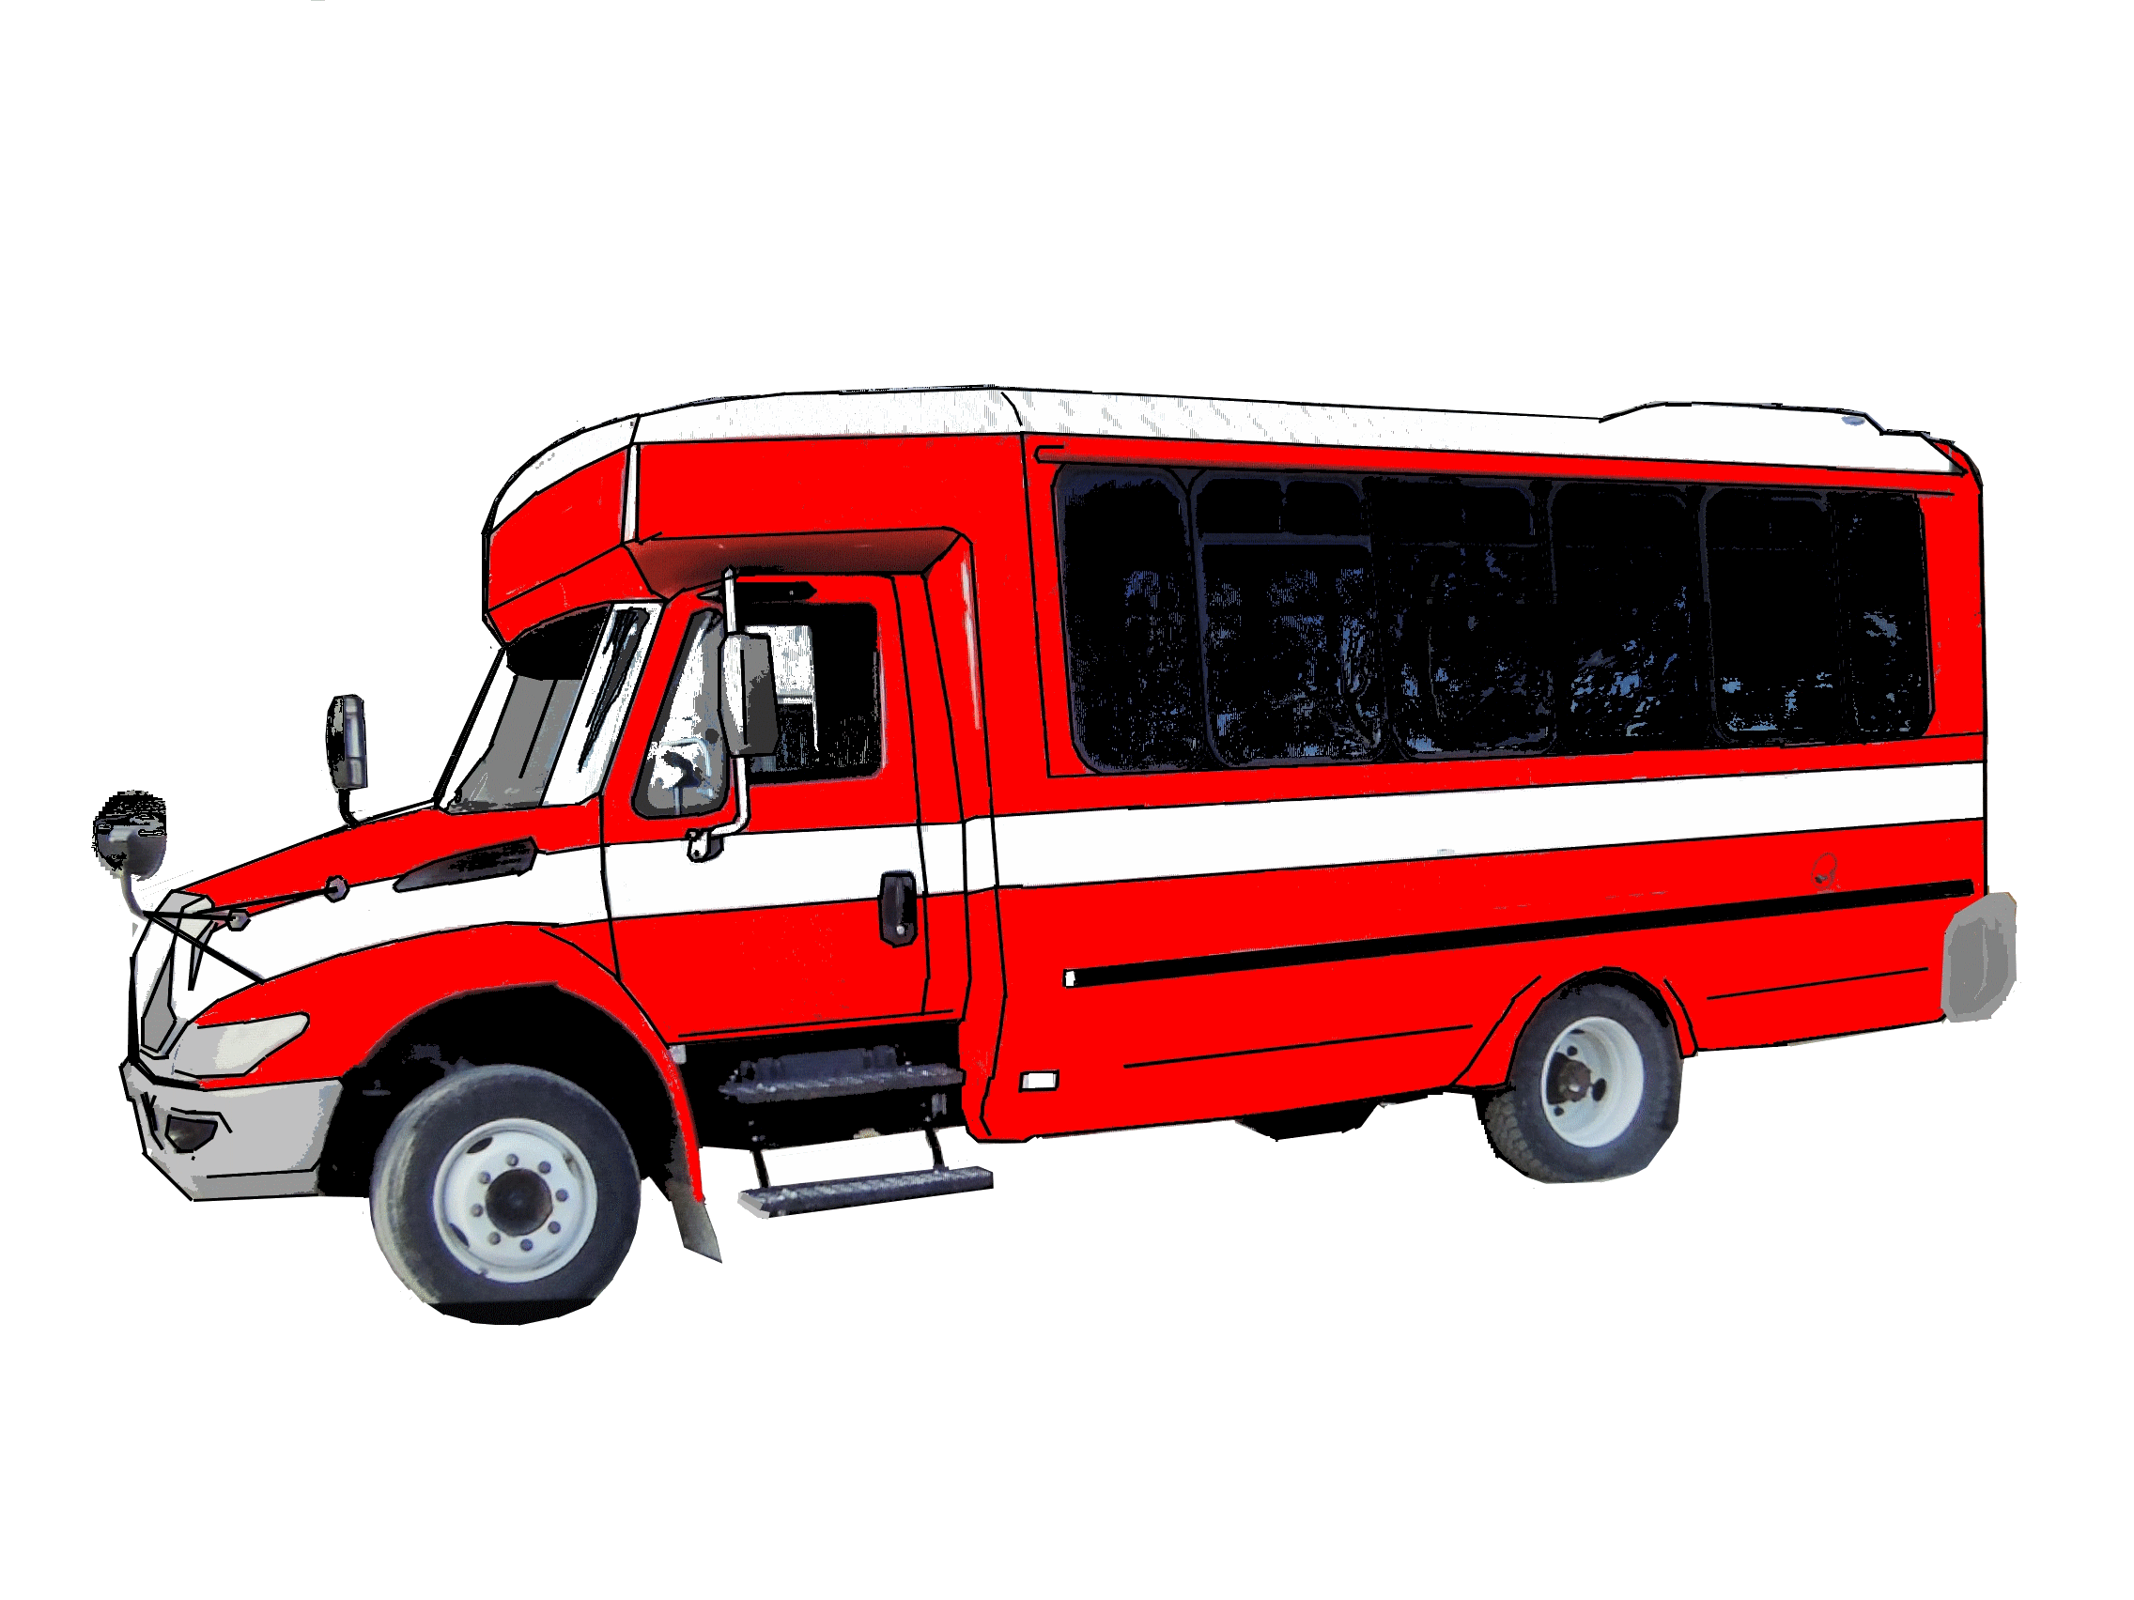

Slide 12
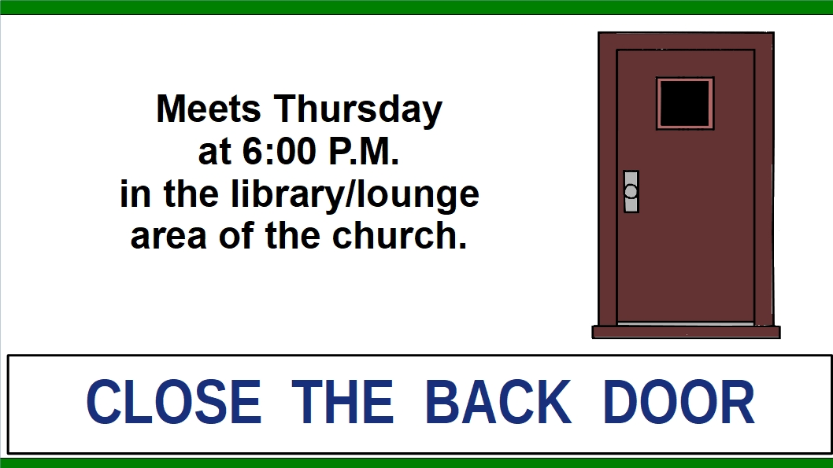

Slide 13

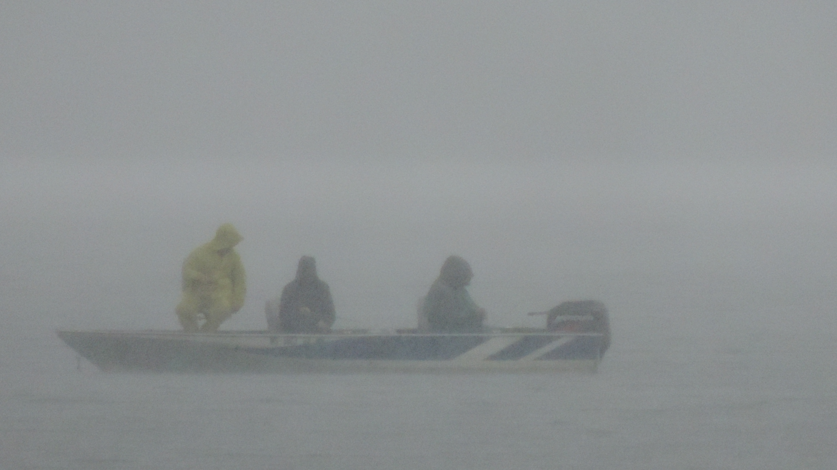

Slide 14
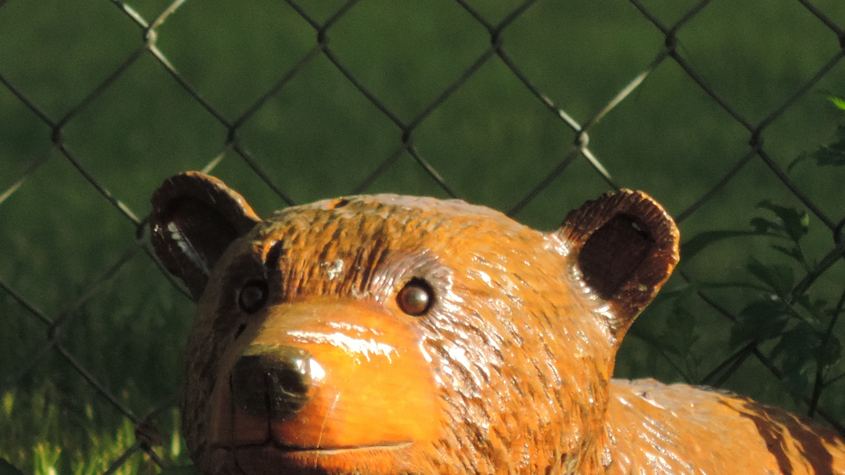
YOUTH GROUP
THURSDAYS at 6:30 p.m.
for Grades 7-12
and
College-age
Photo by N. Hoch

Slide 15


Slide 16


